Slide 1


Project 1
Comparative analysis of Ohio graduation rates and select social economic data, 2002 - 2018
Project Group: Jasmine Jones, Neda Mehdizadeh, Anthony Stevens & Benjy Manning

Slide 2
Outline
Introduction/Objective
Tasks
Cleaning data sets
Merging data sets
Visualizing the data
Statistical analysis
Results and discussion
Conclusions

Slide 3
Objective
Comment(Delete for final):
Jasmine adding library graphic
Investigation of the relationships between the college graduation rate, family income and poverty rate in the state of Ohio using the following Python Libraries:

Slide 4
Sources of Data
Three data sets were obtained, merged and cleaned in the Jupyter notebook with Pandas library:
Median Income and Unemployment data was obtained from the USDA online: (https://www.ers.usda.gov/data-products/county-level-data-sets/download-data/ )
Ohio College Graduation data was obtained from the Ohio Department of Higher Education: (https://www.ohiohighered.org/data-reports/degrees)
Poverty rate data was obtained from the US Census bureau: (https://www.census.gov/data-tools/demo/saipe/#/?map_geoSelector=aa_c&s_state=39&s_year=2019,2018&s_measures=aa_snc&map_yearSelector=2018 )

Slide 5
Initial thoughts on data
We did not expect to be such a large correlation between median income and number of degrees earned.
No expected correlation between poverty rate and degrees earned.
As degrees earned rises, the unemployment rate goes down.

Slide 6
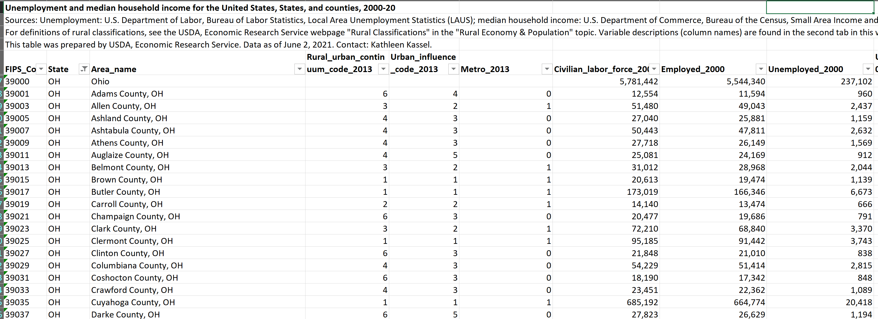
Unemployment and Median Income Data Set

Slide 7
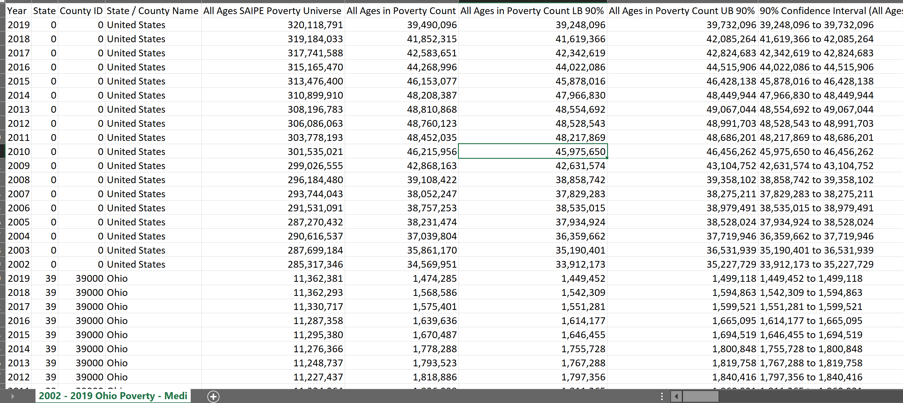
Poverty Data Set

Slide 8
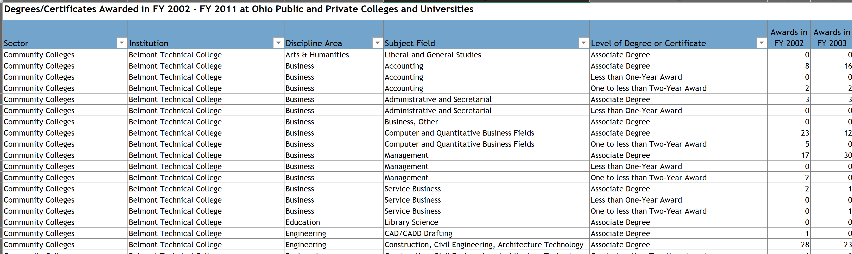
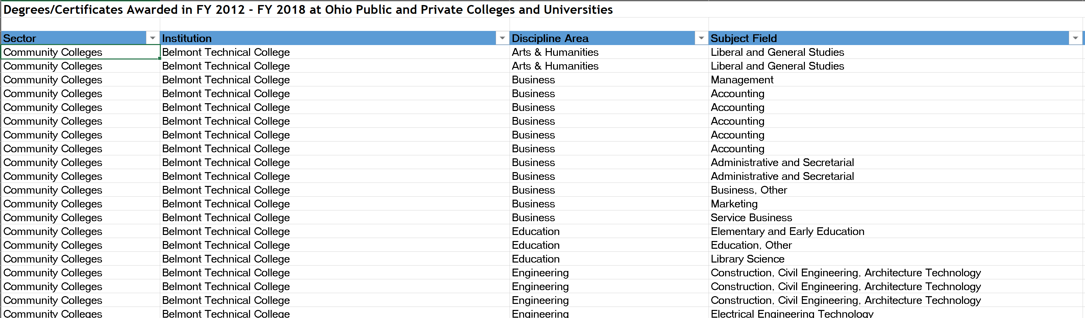
College Graduation Data Set

Slide 9




Data Import and Cleaning
Imported all data sets for cleaning
Renaming columns in all data sets to be more meaningful to analysis
Dropping columns to only use relevant data to analysis
Adding summary columns for total degrees
Adding average unemployment rate for the states and separating for Ohio only
Sample Code:

Slide 10
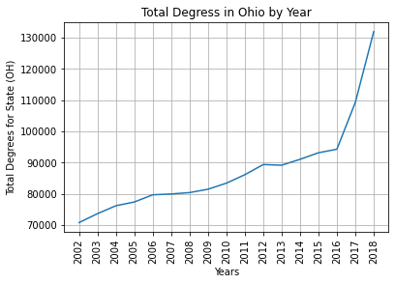
Data Analysis Observations – Total Degrees by Year

Slide 11
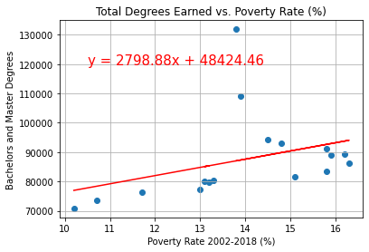
Question 1: Does the poverty rate have an impact on the number of degrees earned from 2002-2018 in Ohio?
In review

Slide 12
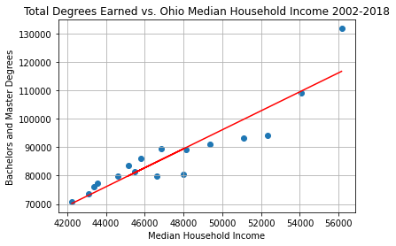
Plot x Overview

Slide 13
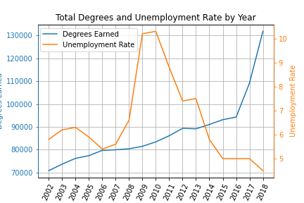
Plot x Overview

Slide 14
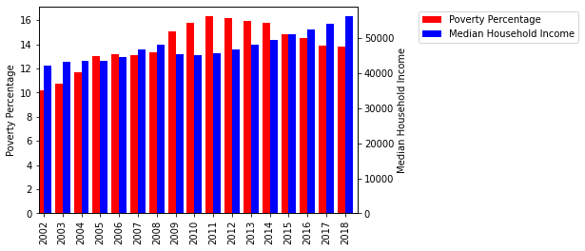
Plot x Overview

Slide 15
Project Conlusion

Slide 17
Sample Data Sets

Slide 18
Sample Data Sets

Slide 21
Sample Data Sets

Slide 25

Thank you for your attention!

